Slide 1
Non-Invasive Blood Group Detection Using Fingerprints
BALLARI INSTITUTE OF TECHNOLOGY AND MANAGEMENT
DEPARTMENT OF COMPUTER SCIENCE AND ENGINEERING
Presented by:
Poorvi H 3BR22CS120
Pragna A 3BR22CS122
Rajeshwari 3BR22CS136
B Fouziya 3BR23CS402
Project Guide
Dr. C K Srinivas
Project Coordinator
Mr. Chandrashekar V

Slide 2
Index
Abstract
Vision, Mission ,Objectives and Problem Statement
Introduction
Literature Survey
Existing System and Proposed System
Feasibility Study
Project Management and Cost Estimation
Hardware and Software Requirements
System Design
Implementation
Results and Discussion
Conclusion and Future Scope
References
Publication Status

Slide 3
Abstract
Non – Invasive Blood Group Detection Using Fingerprints
The Non-Invasive Blood Group Detection Using Fingerprint Project utilizes deep learning techniques to overcome the limitations of traditional blood typing, which require physical samples and lab analysis, making them slow and impractical in many scenarios. This project introduces a fingerprint-based blood group classification system employing leading Convolutional Neural Network (CNN) architectures- ResNet to identify blood groups directly from fingerprint images. By capitalizing on the distinctive patterns inherent in fingerprints and the power of deep learning, the approach offers rapid, user-friendly, and non-invasive blood group detection. This system has significant applications in healthcare diagnostics, biometric identification, and promising greater accessibility and speed compared to conventional methods.

Slide 4
Vision
Non – Invasive Blood Group Detection Using Fingerprints
To revolutionize blood group identification through non-invasive, making rapid and accessible diagnostics a reality for every individual, everywhere.
Mission
To revolutionize blood group identification by introducing a fast, non-invasive, and technology-driven solution using fingerprints.
To harness the power of deep learning to create an reliable system that simplifies and accelerates blood group detection.
To make healthcare more accessible by providing a low-cost and user-friendly alternative to traditional laboratory-based blood testing.

Slide 5
Objectives
Non – Invasive Blood Group Detection Using Fingerprints
To design a non-invasive system that predicts an individual’s blood group using fingerprint images instead of traditional blood samples.
To apply advanced CNN architectures like ResNet for extracting deep fingerprint features and performing blood group classification.
To provide a fast, painless, and user-friendly alternative to conventional blood testing methods.
To enhance accessibility and efficiency in healthcare by offering a low-cost, quick, and reliable method for blood group identification.

Slide 6
Problem Statement
Non – Invasive Blood Group Detection Using Fingerprints
To design and develop a non-invasive, fast blood group identification system using fingerprint images and a deep learning strategy.

Slide 7
Introduction
The project “Non-Invasive Blood Group Detection Using Fingerprints” aims to provide a fast, safe, and user-friendly alternative to traditional blood typing methods. Conventional approaches require collecting blood samples and performing laboratory tests, which can be time-consuming, invasive, and impractical during emergencies. This project addresses these challenges by using fingerprint images and deep learning techniques to predict a person’s blood group. By leveraging biometric patterns and advanced CNN models, the system offers a reliable solution that enhances accessibility, reduces dependency on laboratory setups, and supports rapid medical decision-making.

Slide 8
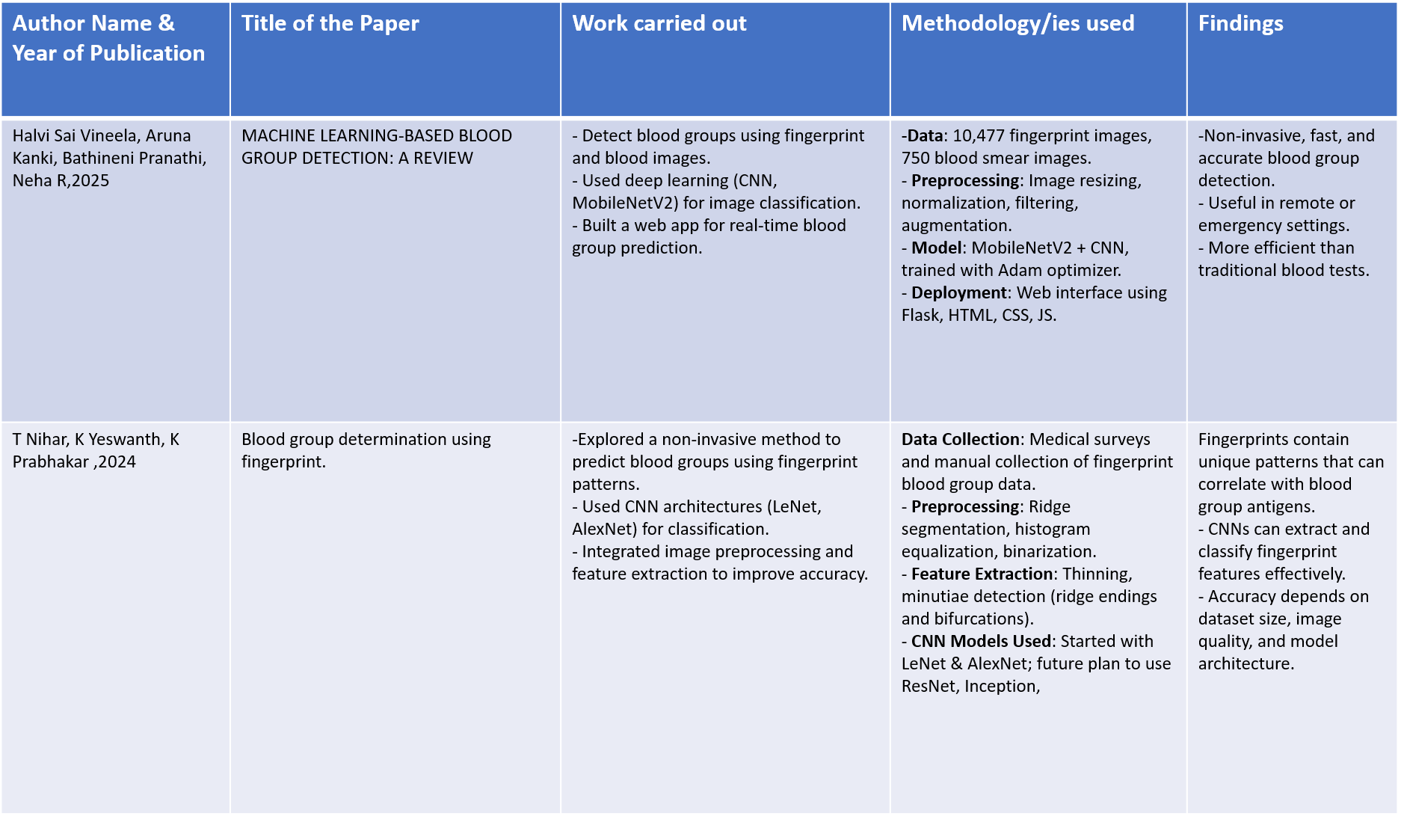
Literature Review
Non – Invasive Blood Group Detection Using Fingerprints

Slide 9
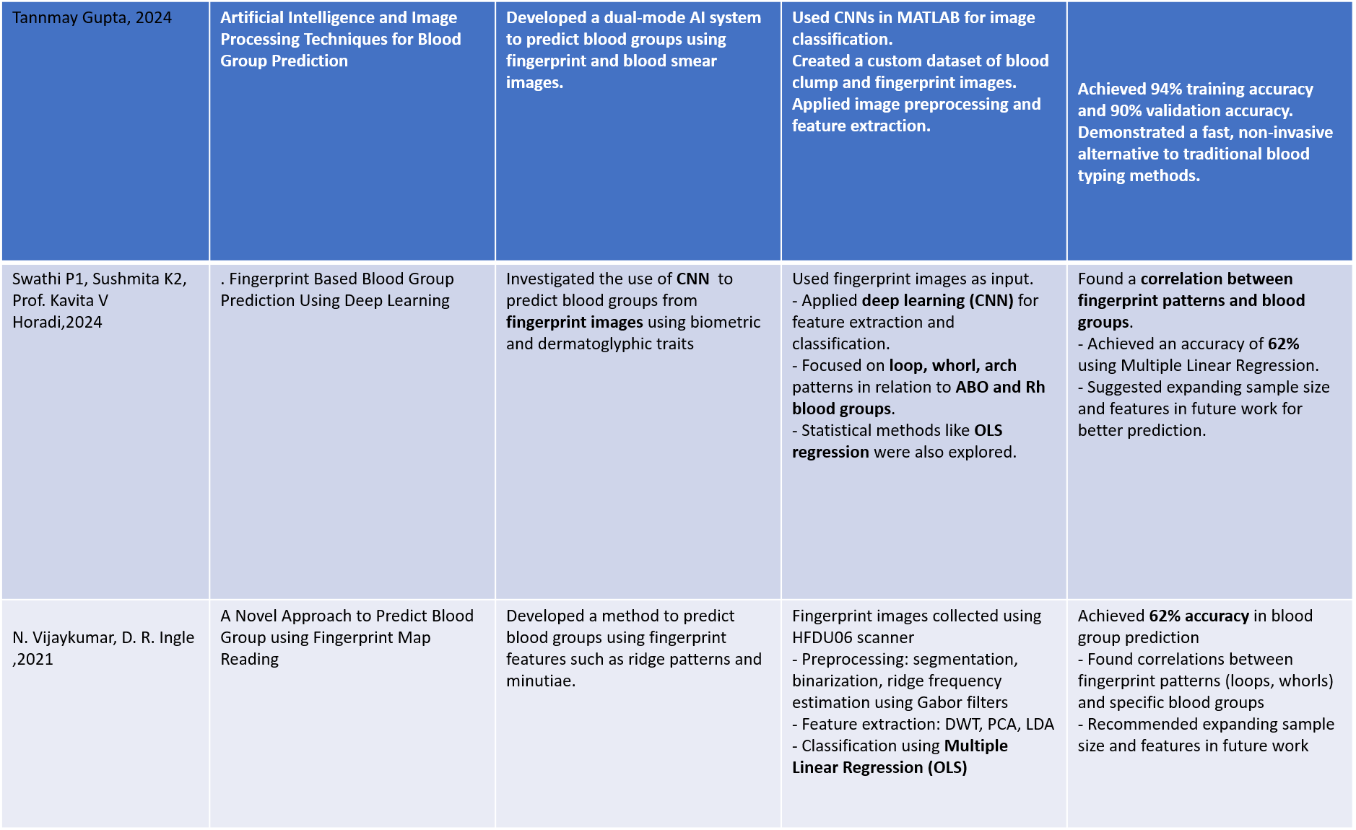
Non – Invasive Blood Group Detection Using Fingerprints

Slide 10
Existing System vs Proposed System
Aspect | Existing System | Proposed system
Input Data | Uses multiple inputs like fingerprints with blood smear or blood images. | Uses only fingerprint images
Invasiveness | Partially invasive | Fully non-invasive
Model Type | Conventional CNNs, ML, or hybrid models | Advanced CNN based on ResNet
Scalability | Limited scalability | Designed for better scalability
Preprocessing | Basic preprocessing techniques | Enhanced preprocessing for better ridge clarity
Speed | Low | High

Slide 11
Feasibility Study
Technical feasibility:
1. Uses widely available technologies (Python, CNN, OpenCV)
2. Tools like TensorFlow, PyTorch support deep learning tasks.
3. Requires only a fingerprint image as input.
Operational Feasibility:
1. Simple process: capture fingerprint → system predicts blood group.
2. Requires minimal training for healthcare workers.
3. Portable and easy to deploy in diverse healthcare settings.

Slide 12
Project Management
The project follows a structured, phase-wise approach to ensure timely and quality outcomes.
1.Planning Phase:
Define project objectives, scope, and deliverables.
Gather requirements for dataset collection, fingerprint preprocessing, and ResNet-based CNN selection.
Create a project schedule and divide tasks among team members.
2.Execution & Monitoring Phase:
Perform data preparation, model development, training, and testing.
Conduct regular progress reviews to track milestones and performance.

Slide 13
3.Quality & Documentation:
Ensure the system meets accuracy, usability, and healthcare standards.
Maintain proper documentation and result analysis.
4.Final Phase:
Plan deployment and prepare final reports.
Evaluate overall system performance for scalability and real-world use.

Slide 14
Cost Estimation(Using COCOMO Model):
The Basic COCOMO (Constructive Cost Model) is used to estimate the effort, development time, team size, and cost of a software project based on its size measured in KLOC (Thousands of Lines of Code).
Our project, Non-Invasive Blood Group Detection Using Fingerprint and AI, is a research-oriented web-based application with moderate algorithmic logic and a flexible development environment. Since the system is developed using standard tools, has manageable complexity, and does not involve strict real-time constraints, it is classified under the Organic project category.

Slide 15
COCOMO Equations Used:
Effort (E) = a × (KLOC)ᵇ (measured in Person-Months)
Development Time (T) = c × (E)ᵈ (measured in Months)
Team Size = Effort / Development Time
Total Cost = Effort × Cost per Person-Month
Project Type: Organic
Project Size: ~7.8 KLOC
Development Time: ~5–6 months
Team Size: 4 members
Cost per Person-Month: ₹350 (academic assumption)
Estimated Total Cost: ₹7,280 (≈ ₹7,500)

Slide 16
System Requirements
Non – Invasive Blood Group Detection Using Fingerprints
Software Requirements:
Computer/Laptop – Minimum Intel i5 processor, 8 GB RAM, 256 GB SSD.
Storage Device – To store fingerprint images, models, and results.
Hardware Requirements:
Operating System – Windows 10/11, Ubuntu, or macOS
Programming Language – Python
Deep Learning Framework – TensorFlow or PyTorch
Libraries – OpenCV, NumPy, Pandas, Matplotlib, scikit-learn
IDE/Editor – Juptyer.

Slide 17
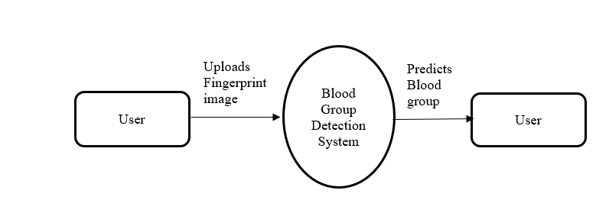
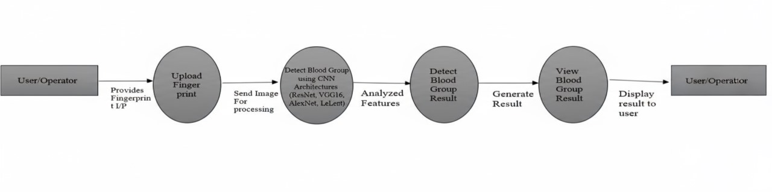
System Design
Non – Invasive Blood Group Detection Using Fingerprints
Data Flow Diagram
Level 0
Level 1

Slide 18
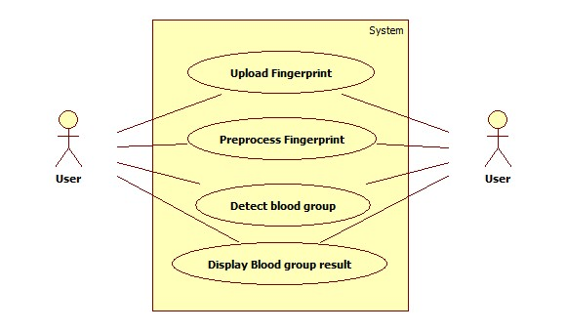
Use case Diagram
Non – Invasive Blood Group Detection Using Fingerprints

Slide 19
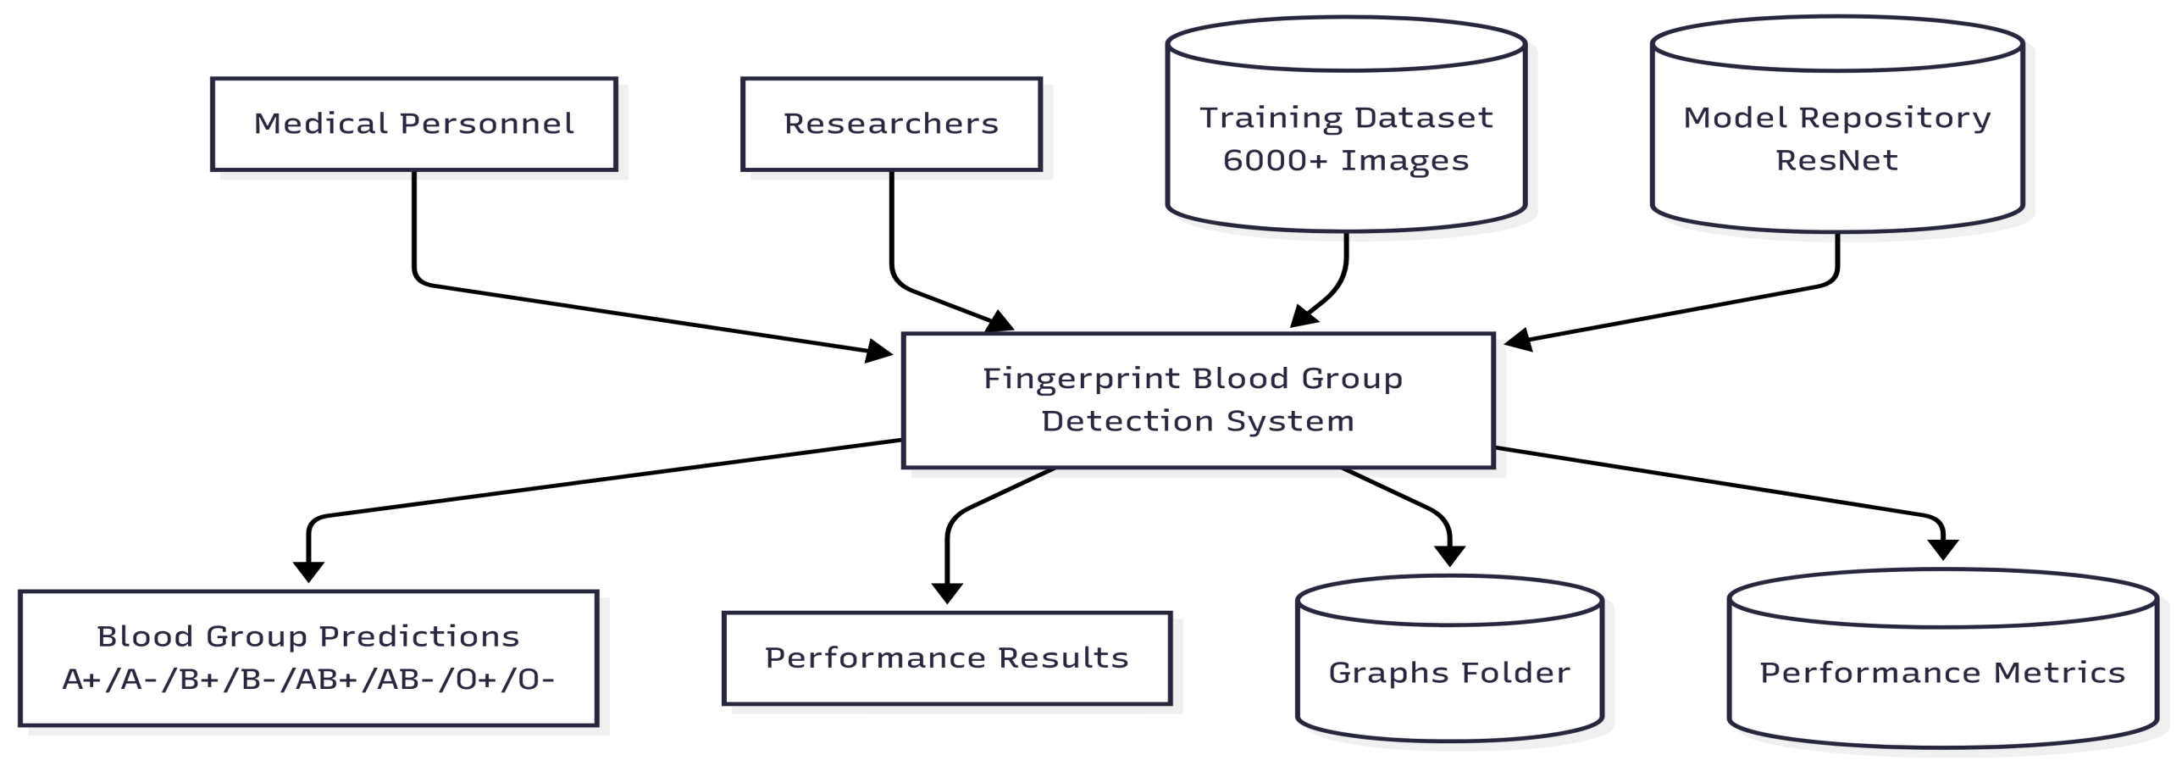
Context Diagram
Non – Invasive Blood Group Detection Using Fingerprints

Slide 20
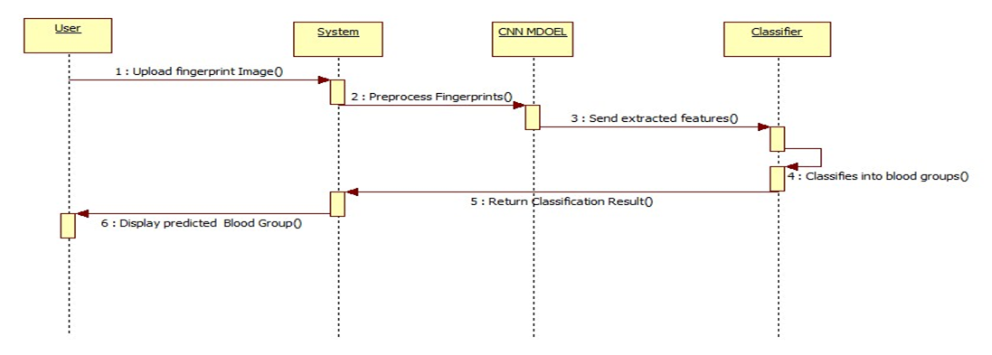
Sequence Diagram
Non – Invasive Blood Group Detection Using Fingerprints

Slide 21
Implementation of modules
1. Image Acquisition Module
Captures fingerprint images from users.
Ensures consistent lighting, proper finger placement, and good ridge clarity.
Provides the raw input required for preprocessing and model training.
2.Preprocessing Module
Resizes all fingerprint images to a standard dimension suitable for CNN models.
Applies noise reduction filters (Gaussian/Median) to remove distortions.
Enhances contrast to improve ridge and valley visibility.
Performs normalization to standardize pixel ranges.
Includes data augmentation like rotation, flipping, and scaling to increase dataset variety and prevent overfitting.

Slide 22
3.CNN Feature Extraction & Classification Module
Uses CNN architectures such as ResNet to automatically extract deep fingerprint features.
Learns ridge flow, ridge texture, and other distinguishing fingerprint characteristics.
Trains the model using labeled fingerprint data across all blood groups (A, B, O, AB, Rh+/).
The final classification layer predicts the blood group based on learned patterns.
4. Model Training & Validation Module
This module is responsible for training and evaluating the CNN model for blood group prediction.
The preprocessed fingerprint dataset is divided into training, validation, and testing sets.
During training, the CNN model (such as ResNet) learns meaningful fingerprint features and
their relationship with blood groups using labeled data. Optimization techniques like learning
rate tuning, dropout, and batch normalization are applied to improve performance and reduce overfitting. Validation is performed using unseen data to measure accuracy, loss, and reliability, ensuring the model generalizes well to new fingerprint inputs.

Slide 23
5. Blood Group Prediction Module
In this module, the trained CNN model is used to predict the blood group from a new fingerprint image.
When a user uploads a fingerprint, the system preprocesses it and passes it to the trained model. The model analyzes extracted features and predicts the most probable blood group (A, B, AB, O with Rh factor).
6. User Interface Module
The user interface module provides a simple and user-friendly platform for interaction.
It allows users to upload their fingerprint image through a graphical interface and initiate the detection process using a single button.

Slide 24
Results and Discussion
The system was tested on fingerprint images from different blood groups. Results show that CNN models like ResNet can learn useful fingerprint features for blood group prediction. Image preprocessing improved ridge clarity and reduced noise, leading to better predictions. The system accurately predicted blood groups (A, B, AB, O with Rh factor) and provided confidence scores through a simple, fast interface. Although confidence varies due to limited data and fingerprint quality, the results confirm the feasibility of non-invasive blood group detection, with scope for improvement using larger datasets.

Slide 25
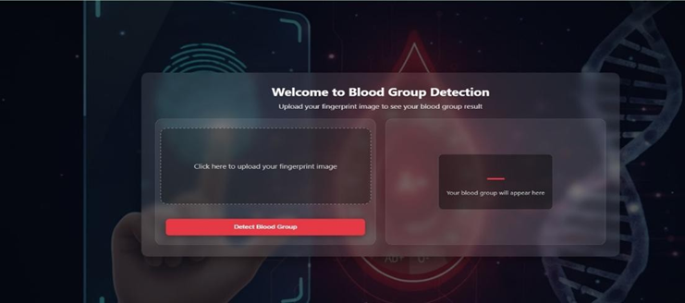
Output:

Slide 26
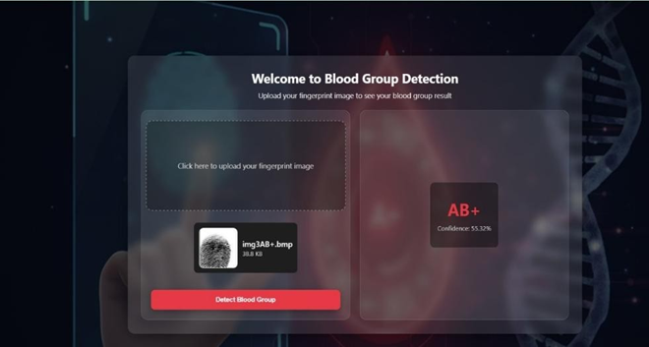

Slide 27
Conclusion
The project “Non-Invasive Blood Group Detection Using Fingerprint” successfully demonstrates an innovative approach to determining blood groups using biometric data and deep learning techniques. By integrating fingerprint image acquisition, preprocessing, and CNN-based classification, the system provides a fast, painless, and user-friendly alternative to conventional blood testing methods. The use of advanced CNN architectures enables effective learning of fingerprint patterns and reliable blood group prediction, making the system suitable for healthcare and biometric applications. Overall, the project highlights the potential of artificial intelligence in medical diagnostics and shows that non-invasive biometric-based solutions can enhance accessibility, efficiency, and digital healthcare services. With further improvements in dataset size and model optimization, the system can be extended into a robust, real-world deployable solution.

Slide 28
Future Scope
The proposed non-invasive blood group detection system has significant potential for further development and real-world deployment. In the future, the model can be enhanced by incorporating larger and more diverse fingerprint datasets to improve accuracy and reliability across different populations. The system can be integrated into mobile and IoT-based health devices, enabling instant blood group identification at the point of care. Advanced deep learning architectures and optimization techniques may further enhance performance while reducing computation time. Additionally, integrating the system into hospital management platforms, emergency response units, and biometric identification systems can greatly expand its practical applications. With continued research, this technology can evolve into a widely adopted, portable, and cost-effective diagnostic tool for global healthcare use.

Slide 29
References
[1]H. S. Vineela, “MACHINE LEARNING-BASED BLOOD GROUP DETECTION: A REVIEW” International Journal of Research, vol. 13, no. 5, pp. 129–135, 2024.
[2] T. Nihar, K. Yeswanth, and K. Prabhakar, “Blood Group Prediction Using Fingerprint Images with CNN and Gabor Filter,” International Journal of Research, vol. 13, no. 5, pp. 122–128, 2024.
[3] T. Gupta, “Blood Group Prediction Using Deep Learning,” International Journal of Advanced Research in Computer Science, vol. 15, no. 2, pp. 45–50, 2024.
[4] P1 S. Swathi, Sushmitha, and Prof. Kavita, “Fingerprint Based Blood Group Prediction Using Deep Learning,” International Journal of Research, vol. 13, no. 5, pp. 136–142, 2024.
[5] Gupta, A., Agarwal, S., & Jain, R., et al. Investigates the use of machine learning algorithms, including Support Vector Machines (SVM) and Random Forests (RF), for blood group identification using fingerprint images. (2023).
[6] Verma, A., & Bhatt, V., et al. Provides n overview of automated blood group identification methods based on fingerprint nalysis and the use of machine learning algorithms.(Feb 11,2022).
[7] Vijaykumar Patil N, D. R. Ingle. A Novel approach to predict blood group using fingerprint map reading and the use of HFDU06 Scanner. (Apr 02-04,2021).
[8] M. Mondal, M. Katun, U. K. Suma, and Md. R. Islam, “Blood group identification based on fingerprint by using 2D Discrete wavelet and binary transform,”modeling, measurement and control C, vol.80, no.2, pp.63-70,2019.
[9] H. AIshehri, M. Hussain, H. AboAISamh, Q. Emad-ul-Haq, and A. M. Azmi, “Alignment-free cross-sensor fingerprint matching based on the Co-Occurrence of ridge Orientations and Gabor-HoG Descriptor”.
[10] Dr. D. Shiva Sundhara Raj and J Abinaya”A Cost-effective method for blood group detection using fingerprints”, International journal of advance study and research work, vol.2, march 2019.

Slide 30
Publication status
The project titled “Non-Invasive Blood Group Detection Using Fingerprint Images” presents an innovative approach, and a patent application related to this work has been filed. The application is currently under review by the Indian Patent Office (https://en.wikipedia.org/wiki/Indian_Patent_Office).

Slide 31
Thank You

